Slide 1

Hospital Management System – SQL Project
Database Design & Analytics
Tools: PostgreSQL / MySQL
Created by: Dhiman Chakraborty

Slide 2

Problem Statement
Current Challenges
The Solution
A centralized, normalized relational database provides query-ready structured data, enabling real-time analytics, streamlined operations, and evidence-based healthcare management across all departments and workflows.
Manual or fragmented systems plague hospital operations, leading to inefficiencies, data silos, and delayed decision-making. Without centralized data management, hospitals struggle to track patient histories, optimize resource allocation, and generate timely reports.

Slide 3



Project Objectives
Normalized Design
Comprehensive Data Management
Analytical Reporting
Build a fully normalized relational database following 1NF, 2NF, and 3NF principles to eliminate redundancy and ensure data integrity.
Enable advanced SQL-based reporting and analytics for operational insights, performance metrics, and strategic decision-making.
Store and manage patient demographics, doctor schedules, appointments, admissions, treatments, prescriptions, lab results, and billing data.

Slide 4





System Overview
Hospital Operations Workflow
Patient Registration
New patient intake and demographic data capture
Appointment Scheduling
Doctor availability matching and booking confirmation
Admission
Room assignment and in-patient care initiation
Treatment & Testing
Care delivery, medication, and lab procedures
Billing
Invoice generation and payment processing

Slide 5

Database Schema Overview
Entity-Relationship Architecture
The database employs a star-schema approach with normalized fact and dimension tables. Primary keys (PK) uniquely identify records, while foreign keys (FK) establish referential integrity across related entities.
Key relationships:
Patients → Appointments → Doctors
Admissions → Rooms → Departments
Treatments → Medications → Prescriptions
Lab Tests → Lab Results → Patients
Invoices → Invoice Lines → Services

Slide 6
Core Tables & Data Volume
The database simulates a large metropolitan hospital system with realistic operational scale:
20
2K
200K
5K
Departments
Doctors
Patients
Rooms
Specialized medical units
Medical practitioners
Registered individuals
In-patient facilities
700K
30K
80K
500
Appointments
Admissions
Treatments
Medications
Scheduled consultations
Hospital stays
Medical procedures
Drug inventory
150K
100
100K
150K
Prescriptions
Lab Tests
Lab Results
Invoices
Medication orders
Diagnostic procedures
Test outcomes
Billing statements

Slide 7


Normalization Approach
01
02
First Normal Form (1NF)
Second Normal Form (2NF)
Eliminated repeating groups and ensured atomic values in all columns. Each cell contains single, indivisible data points with no multi-valued attributes.
Removed partial dependencies by ensuring all non-key attributes fully depend on the entire primary key, preventing redundancy in composite key scenarios.
03
Third Normal Form (3NF)
Eliminated transitive dependencies where non-key attributes depend on other non-key attributes, creating separate tables for independent entity relationships.
Result: Minimized data redundancy, prevented update anomalies, and ensured referential integrity across all table relationships.

Slide 8

SQL Features Demonstrated
Complex Joins
Aggregate Functions
INNER, LEFT, RIGHT, and FULL OUTER joins connecting multiple tables for comprehensive data retrieval
SUM, AVG, COUNT, MIN, MAX with GROUP BY for statistical summaries
Subqueries
Common Table Expressions
Correlated and non-correlated subqueries for filtering and calculation
CTEs for modular, readable query construction and recursive operations
Date & String Functions
Window Functions
DATEPART, DATEDIFF, CONCAT, and pattern matching for data transformation
ROW_NUMBER, RANK, DENSE_RANK, and running totals for advanced analytics

Slide 9
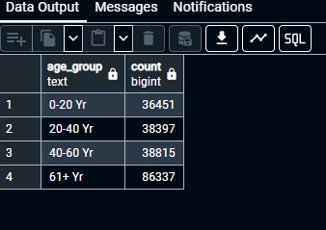
SQL Queries
--1. Patients count by age group
SELECT
CASE
WHEN EXTRACT(YEAR FROM AGE(dob)) <=20 THEN '0-20 Yr'
WHEN EXTRACT(YEAR FROM AGE(dob)) BETWEEN 21 AND 40 THEN '20-40 Yr'
WHEN EXTRACT(YEAR FROM AGE(dob)) BETWEEN 41 AND 60 THEN '40-60 Yr'
ELSE '61+ Yr' END AS age_group,
COUNT(*)
FROM patient
GROUP BY age_group
ORDER BY age_group;

Slide 10
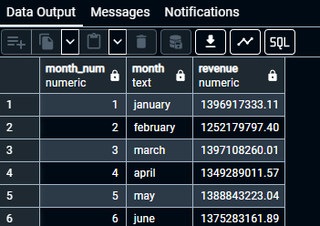
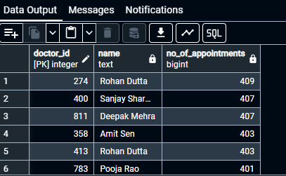
--2.Monthly revenue (invoice totals) for last 12 months
SELECT EXTRACT(MONTH FROM invoice_date) AS month_num,
TO_CHAR(invoice_date,'month') AS month,
SUM(total_amount) AS revenue
FROM invoice
WHERE invoice_date >= DATE_TRUNC('month',invoice_date) - INTERVAL '12 months'
GROUP BY month,month_num
ORDER BY month_num;
--3.Top 10 doctors by number of appointments in past 6 months
SELECT d.doctor_id,CONCAT(d.first_name,' ',d.last_name) AS name,
COUNT(a.*) AS no_of_appointments
FROM doctor d
LEFT JOIN appointment a USING (doctor_id)
GROUP BY d.doctor_id,CONCAT(d.first_name,' ',d.last_name)
ORDER BY no_of_appointments DESC, d.doctor_id ASC
LIMIT 10;

Slide 11
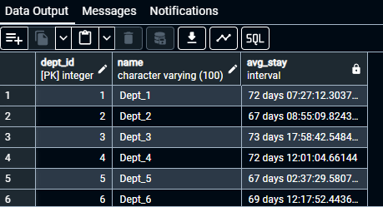
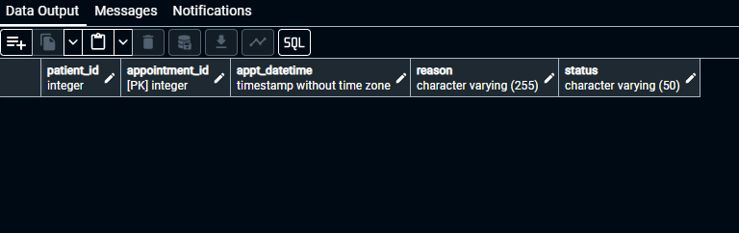
--4.Average length of stay (days) by department (based on admitting doctor’s dept)
SELECT d.dept_id,d.name,
AVG(COALESCE(a.discharge_date,CURRENT_DATE)-a.admit_date) AS avg_stay
FROM department d
LEFT JOIN doctor dc USING (dept_id)
JOIN admission a USING (doctor_id)
GROUP BY d.dept_id,d.name
ORDER BY 1;
--5.Latest appointment for each patient(Upcoming 30 days)
SELECT patient_id, appointment_id, appt_datetime, reason, status
FROM appointment
WHERE appt_datetime >= CURRENT_DATE + INTERVAL '30 DAYS'
ORDER BY appt_datetime;

Slide 12
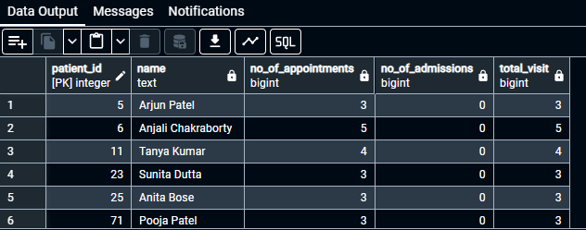
--6.Patients with more than 3 visits (appointments + admissions) in past year
WITH app AS(
SELECT p.patient_id,CONCAT_WS(' ',p.first_name,p.last_name) AS name,
COUNT(a.*) no_of_appoinments
FROM patient p
LEFT JOIN appointment a USING (patient_id)
WHERE a.appt_datetime >= DATE_TRUNC('year',CURRENT_DATE) - INTERVAL'1 YEAR' AND a.appt_datetime <= DATE_TRUNC('year',CURRENT_DATE)
GROUP BY p.patient_id,CONCAT_WS(' ',p.first_name,p.last_name)
),
add AS(
SELECT p.patient_id,CONCAT_WS(' ',p.first_name,p.last_name) AS name,
COUNT(ad.*) no_of_admission
FROM patient p
LEFT JOIN admission ad USING (patient_id)
WHERE ad.admit_date >= DATE_TRUNC('year',CURRENT_DATE) - INTERVAL'1 YEAR' AND ad.admit_date <= DATE_TRUNC('year',CURRENT_DATE)
GROUP BY p.patient_id,CONCAT_WS(' ',p.first_name,p.last_name)
)
SELECT p.patient_id,CONCAT_WS(' ',p.first_name,p.last_name) AS name,
COALESCE(app.no_of_appoinments,0) AS no_of_appointments,
COALESCE(add.no_of_admission,0) AS no_of_admissions,
COALESCE(app.no_of_appoinments,0)+COALESCE(add.no_of_admission,0) AS total_visit
FROM patient p
LEFT JOIN app USING (patient_id)
LEFT JOIN add USING (patient_id)
WHERE COALESCE(app.no_of_appoinments,0)+COALESCE(add.no_of_admission,0)>=3
ORDER BY 1;

Slide 13
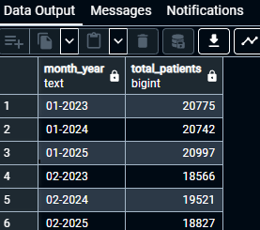
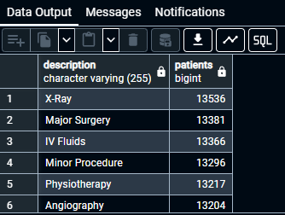
--7.Monthly count of patients (by registration = earliest appointment/admission date)
WITH app AS (
SELECT TO_CHAR(appt_datetime,'mm-yyyy') AS month_year,
COUNT(*) AS total_appointments
FROM appointment
GROUP BY 1
),
adm AS (
SELECT TO_CHAR(admit_date,'mm-yyyy') AS month_year,
COUNT(*) AS total_admissions
FROM admission
GROUP BY 1
)
SELECT app.month_year,
app.total_appointments + adm.total_admissions AS total_patients
FROM app
JOIN adm USING (month_year)
ORDER BY app.month_year;
--8.Top 20 most common treatments (by description)
SELECT description, COUNT(*) AS patients
FROM treatment
GROUP BY 1
ORDER BY patients DESC;

Slide 14
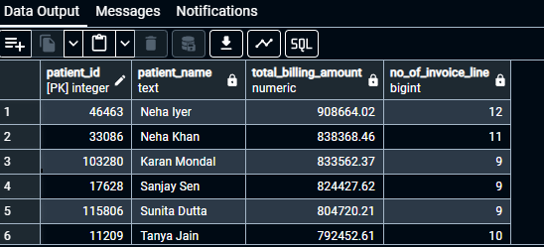
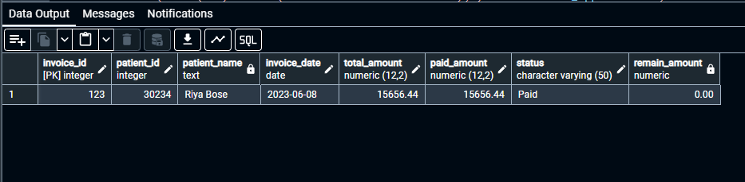
--9.Total invoice amount and lines per patient (showing patients with largest bills)
WITH bill AS(
SELECT patient_id,
SUM(total_amount) AS bill_amount
FROM invoice
GROUP BY 1
),
inl AS(
SELECT i.patient_id,
COUNT(il.*) AS no_of_invoice_line
FROM invoice i
JOIN invoice_line il USING (invoice_id)
GROUP BY 1
)
SELECT p.patient_id,CONCAT_WS(' ',p.first_name,p.last_name) AS patient_name,
COALESCE(bill.bill_amount,0) AS total_billing_amount,
COALESCE(inl.no_of_invoice_line,0) AS no_of_invoice_line
FROM patient p
LEFT JOIN bill USING (patient_id)
LEFT JOIN inl USING (patient_id)
ORDER BY total_billing_amount DESC
LIMIT 50;
--10.Invoice line breakdown for a given invoice (example invoice_id = 123)
SELECT i.invoice_id,
i.patient_id,
CONCAT_WS(' ',p.first_name,p.last_name) AS patient_name,
i.invoice_date,
i.total_amount,
i.paid_amount,
i.status,
i.total_amount - i.paid_amount AS remain_amount
FROM invoice i
JOIN patient p USING (patient_id)
WHERE i.invoice_id=123;

Slide 15
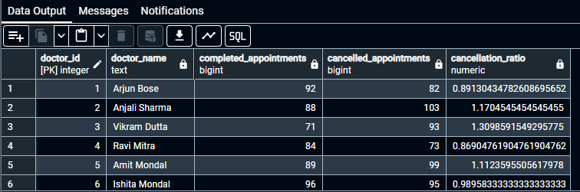
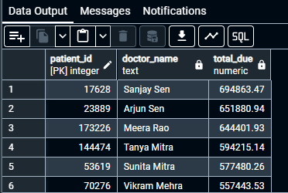
--11.Doctors ranked by average patient satisfaction proxy — using completed appointments count and canceled ratio
SELECT d.doctor_id,CONCAT_WS(' ',d.first_name,d.last_name) AS doctor_name,
COALESCE(COUNT(a.*) FILTER(WHERE a.status='Completed'),0) AS completed_appointments,
COALESCE(COUNT(a.*) FILTER(WHERE a.status='Cancelled'),0) AS cancelled_appointments,
COALESCE(COUNT(a.*) FILTER(WHERE a.status='Cancelled'),0)/COALESCE(COUNT(a.*) FILTER(WHERE a.status='Completed'),0)::numeric AS cancellation_ratio
FROM doctor d
LEFT JOIN appointment a USING (doctor_id)
GROUP BY d.doctor_id,doctor_name
ORDER BY 1;
--12.Patients with outstanding balance (due > 0) and total due amount
SELECT p.patient_id,CONCAT_WS(' ',p.first_name,p.last_name) AS doctor_name,
COALESCE(SUM(i.total_amount-i.paid_amount),0) AS total_due
FROM patient p
LEFT JOIN invoice i USING (patient_id)
GROUP BY p.patient_id,doctor_name
ORDER BY total_due DESC;

Slide 16

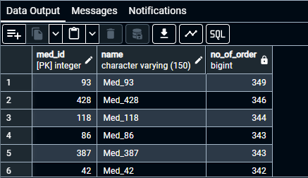
--13.Average cost per admission (including treatments performed during that admission)
WITH add_treat AS(
SELECT a.admission_id,COALESCE(SUM(t.unit_cost),0) AS total_cost
FROM admission a
LEFT JOIN treatment t USING (admission_id)
GROUP BY 1
ORDER BY 1
)
SELECT AVG(total_cost) AS avg_admission_cost
FROM add_treat;
--14.Most frequently prescribed medication names (top 25)
SELECT m.med_id,m.name,
COUNT(p.*) AS no_of_order
FROM medication m
JOIN prescription p USING (med_id)
GROUP BY 1
ORDER BY no_of_order DESC
LIMIT 25;

Slide 17
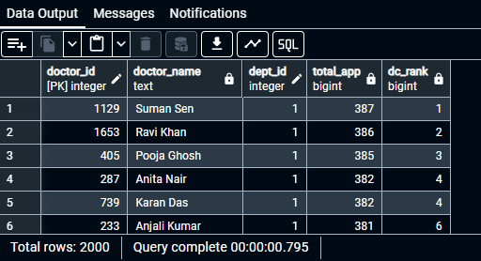
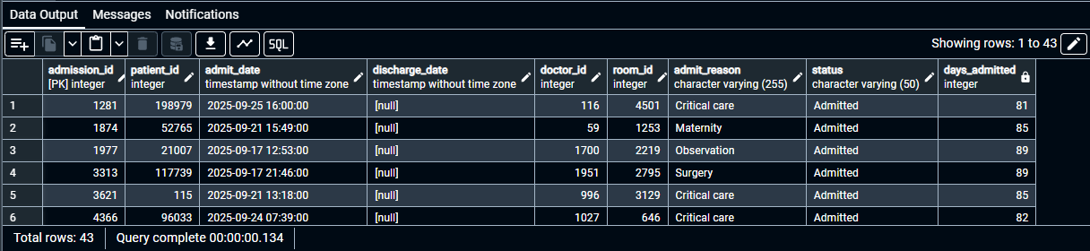
--15.Use window function to show each doctor’s total appointments and rank within department
WITH app AS (
SELECT doctor_id,
COUNT(*) AS total_app
FROM appointment
GROUP BY 1
)
SELECT d.doctor_id,
CONCAT_WS(' ',d.first_name,d.last_name) AS doctor_name,
d.dept_id,
app.total_app,
RANK() OVER(PARTITION BY d.dept_id ORDER BY app.total_app DESC) AS dc_rank
FROM doctor d
JOIN app USING (doctor_id);
--16.List admissions without discharge (current inpatients admitted in 3 month) with room and days admitted
SELECT *,
CURRENT_DATE::DATE - admit_date::DATE AS days_admitted
FROM admission
WHERE admit_date>= CURRENT_DATE - INTERVAL'3 months' AND status='Admitted';

Slide 18
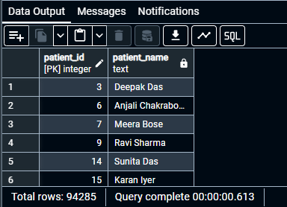
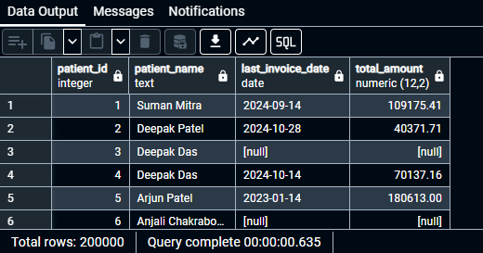
--17.Find patients who have never had an invoice (possible missed billing)
SELECT p.patient_id,CONCAT_WS(' ',p.first_name,p.last_name) AS patient_name
FROM patient p
LEFT JOIN invoice i USING (patient_id)
GROUP BY 1
HAVING COUNT(i.*)=0;
--18.Correlated subquery — latest invoice amount per patient
SELECT DISTINCT ON (p.patient_id)
p.patient_id,p.first_name||' '||p.last_name AS patient_name,
i.invoice_date AS last_invoice_date,
i.total_amount
FROM patient p
LEFT JOIN invoice i USING (patient_id)
ORDER BY 1;

Slide 19
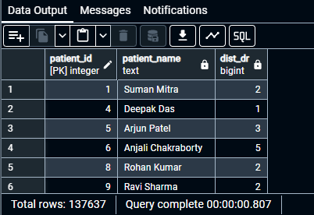
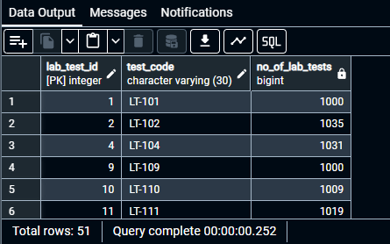
--19.Patients with most different doctors seen in last year
SELECT p.patient_id,p.first_name||' '||p.last_name AS patient_name,
COUNT(DISTINCT a.doctor_id) AS dist_dr
FROM patient p
LEFT JOIN appointment a USING (patient_id)
WHERE a.appt_datetime>=DATE_TRUNC('year',CURRENT_DATE) - INTERVAL'1 year' AND a.appt_datetime<DATE_TRUNC('year',CURRENT_DATE)
GROUP BY 1;
--20.List lab tests ordered more than X times (X=1000)
SELECT l.lab_test_id,l.test_code,
COUNT(lr.*) AS no_of_lab_tests
FROM lab_test l
LEFT JOIN lab_result lr USING (lab_test_id)
GROUP BY 1
HAVING COUNT(lr.*)>=1000
ORDER BY 1;

Slide 20
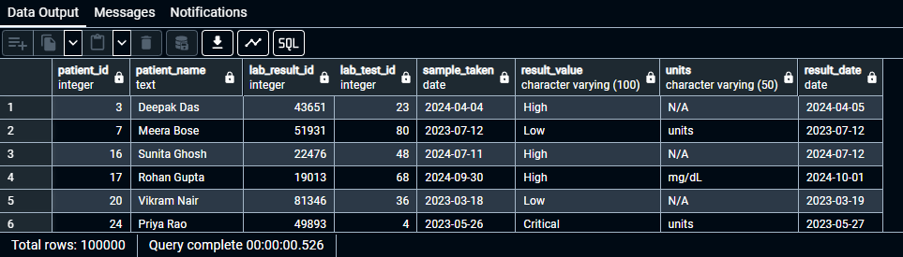
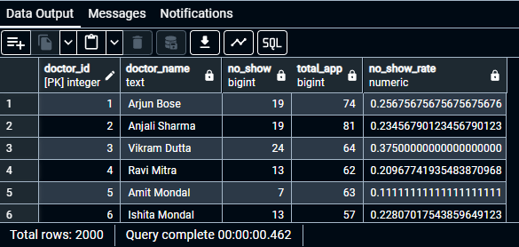
--21.Latest lab result per patient
SELECT p.patient_id,p.first_name||' '||p.last_name AS patient_name,
lr.lab_result_id,
lr.lab_test_id,
lr.sample_taken::DATE,
lr.result_value,
lr.units,
lr.result_date::DATE
FROM patient p
JOIN lab_result lr USING (patient_id)
ORDER BY 1;
--22.Identify no-show rate per doctor in past 6 months
SELECT d.doctor_id,d.first_name||' '||d.last_name AS doctor_name,
COUNT(a.*) FILTER(WHERE a.status='No-Show') AS no_show,
COUNT(a.*) AS total_app,
COUNT(a.*) FILTER(WHERE a.status='No-Show')/COUNT(a.*)::Numeric AS no_show_rate
FROM doctor d
LEFT JOIN appointment a USING (doctor_id)
WHERE a.appt_datetime>=CURRENT_DATE - INTERVAL '6 month'
GROUP BY 1
ORDER BY 1;

Slide 21
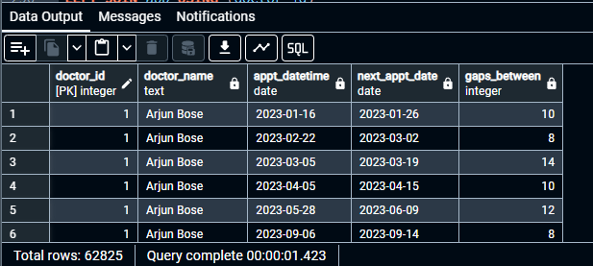
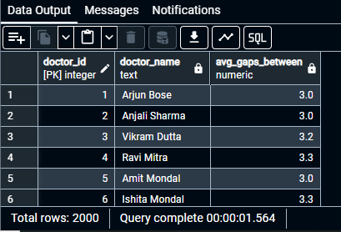
--23.Find gaps between appointments for each doctor — using lead() to detect > 7 days gap
WITH app AS(
SELECT doctor_id,
appt_datetime::DATE,
LEAD(appt_datetime) OVER(PARTITION BY doctor_id ORDER BY appt_datetime ASC)::DATE AS next_appt_date
FROM appointment
)
SELECT d.doctor_id,d.first_name||' '||d.last_name AS doctor_name,
app.appt_datetime::DATE,
app.next_appt_date::DATE,
app.next_appt_date::DATE - app.appt_datetime::DATE AS gaps_between
FROM doctor d
LEFT JOIN app USING (doctor_id)
WHERE app.next_appt_date::DATE - app.appt_datetime::DATE>7
ORDER BY 1;
--24.Find avg gaps between appointments for each doctor
WITH app AS(
SELECT doctor_id,
appt_datetime::DATE,
LEAD(appt_datetime) OVER(PARTITION BY doctor_id ORDER BY appt_datetime ASC)::DATE AS next_appt_date
FROM appointment
)
SELECT d.doctor_id,d.first_name||' '||d.last_name AS doctor_name,
ROUND(AVG(app.next_appt_date::DATE - app.appt_datetime::DATE),1) AS avg_gaps_between
FROM doctor d
LEFT JOIN app USING (doctor_id)
GROUP BY 1
ORDER BY 1;

Slide 22
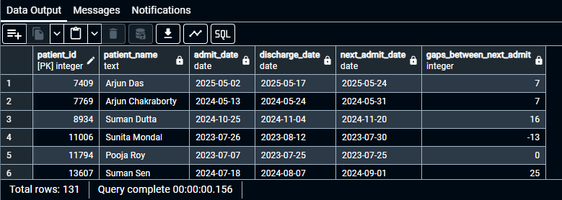
--25.Find patients readmitted within 30 days of discharge
WITH ad AS(
SELECT patient_id, admit_date::DATE, discharge_date::DATE,
LEAD(admit_date) OVER(PARTITION BY patient_id ORDER BY admit_date ASC)::DATE next_admit_date
FROM admission
WHERE discharge_date IS NOT NULL
)
SELECT p.patient_id,p.first_name||' '||p.last_name AS patient_name,
ad.admit_date::DATE,
ad.discharge_date::DATE,
ad.next_admit_date::DATE,
ad.next_admit_date::DATE - ad.discharge_date::DATE AS gaps_between_next_admit
FROM patient p
JOIN ad USING (patient_id)
WHERE next_admit_date IS NOT NULL AND ad.next_admit_date::DATE - ad.discharge_date::DATE<30
ORDER BY 1;

Slide 23
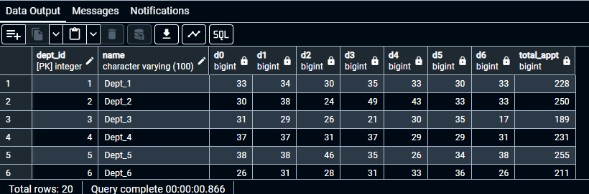
--26.Create a pivot-like daily appointment counts per department for last 7 days (dept names as rows)
WITH dep AS(
SELECT d.dept_id,d.name,
COUNT(a.*) FILTER(WHERE appt_datetime::DATE=CURRENT_DATE::DATE - INTERVAL '6 days') AS d0,
COUNT(a.*) FILTER(WHERE appt_datetime::DATE=CURRENT_DATE::DATE - INTERVAL '5 days') AS d1,
COUNT(a.*) FILTER(WHERE appt_datetime::DATE=CURRENT_DATE::DATE - INTERVAL '4 days') AS d2,
COUNT(a.*) FILTER(WHERE appt_datetime::DATE=CURRENT_DATE::DATE - INTERVAL '3 days') AS d3,
COUNT(a.*) FILTER(WHERE appt_datetime::DATE=CURRENT_DATE::DATE - INTERVAL '2 days') AS d4,
COUNT(a.*) FILTER(WHERE appt_datetime::DATE=CURRENT_DATE::DATE - INTERVAL '1 days') AS d5,
COUNT(a.*) FILTER(WHERE appt_datetime::DATE=CURRENT_DATE::DATE ) AS d6
FROM department d
LEFT JOIN doctor dr USING (dept_id)
JOIN appointment a USING (doctor_id)
GROUP BY 1
ORDER BY 1
)
SELECT d.dept_id,d.name,
dep.d0,dep.d1,dep.d2,dep.d3,dep.d4,dep.d5,dep.d6,
dep.d0+dep.d1+dep.d2+dep.d3+dep.d4+dep.d5+dep.d6 AS total_appt
FROM department d
JOIN dep USING (dept_id)
ORDER BY 1;

Slide 24
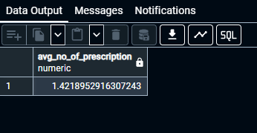
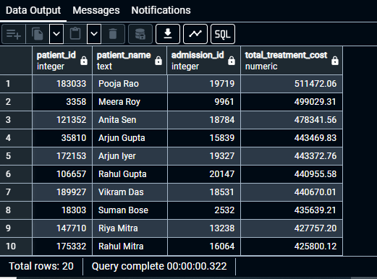
--27.Average number of prescriptions per patient (for patients with at least one Rx)
WITH prs AS (
SELECT p.patient_id,p.first_name||' '||p.last_name AS patient_name,
COUNT(pr.*) AS no_of_prescription
FROM patient p
JOIN prescription pr USING (patient_id)
GROUP BY 1
ORDER BY 1
)
SELECT AVG(no_of_prescription) AS avg_no_of_prescription
FROM prs;
--28.Patients with most expensive single admission (top 20)
WITH trt AS(
SELECT admission_id,
SUM(unit_cost) AS total_treatment_cost
FROM treatment
GROUP BY 1
ORDER BY 1
)
SELECT p.patient_id,p.first_name||' '||p.last_name AS patient_name,
trt.admission_id,
trt.total_treatment_cost
FROM patient p
JOIN admission USING (patient_id)
JOIN trt USING (admission_id)
ORDER BY trt.total_treatment_cost DESC
LIMIT 20;

Slide 25
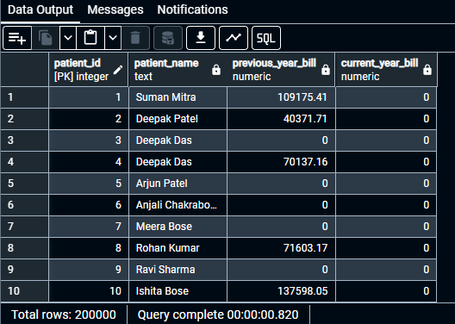
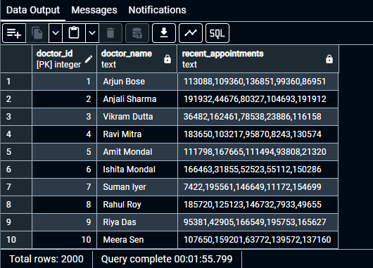
--29.For each patient show total billed this year and last year side-by-side using conditional aggregation
SELECT p.patient_id,p.first_name||' '||p.last_name AS patient_name,
COALESCE(SUM(i.total_amount) FILTER(WHERE EXTRACT(YEAR FROM i.invoice_date)=2024),0) AS previous_year_bill,
COALESCE(SUM(i.total_amount) FILTER(WHERE EXTRACT(YEAR FROM i.invoice_date)=2025),0) AS current_year_bill
FROM patient p
LEFT JOIN invoice i USING (patient_id)
GROUP BY 1
ORDER BY 1;
--30.Use string_agg to return doctor profile with recent 5 appointments
SELECT
d.doctor_id,
d.first_name || ' ' || d.last_name AS doctor_name,
STRING_AGG(a.patient_id::text, ',' ORDER BY a.appt_datetime DESC) AS recent_appointments
FROM doctor d
LEFT JOIN LATERAL (
SELECT a.patient_id, a.appt_datetime
FROM appointment a
WHERE a.doctor_id = d.doctor_id
ORDER BY a.appt_datetime DESC
LIMIT 5
) a ON TRUE
GROUP BY d.doctor_id, doctor_name
ORDER BY d.doctor_id;

Slide 26
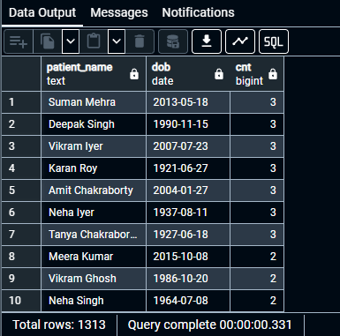

--31.Find duplicate patients by same name + DOB (possible duplicates)
SELECT first_name||' '||last_name AS patient_name,
dob,
COUNT(*) AS cnt
FROM patient
GROUP BY 1,2
HAVING COUNT(*)>1
ORDER BY cnt DESC;
--32.Find doctors with zero appointments in past year (possibly inactive)
SELECT
d.doctor_id,
d.first_name || ' ' || d.last_name AS doctor_name,
EXTRACT(YEAR FROM a.appt_datetime) AS year,
COUNT(a.*) AS no_of_appt
FROM doctor d
LEFT JOIN appointment a USING (doctor_id)
GROUP BY 1,2,3
HAVING EXTRACT(YEAR FROM a.appt_datetime)=2024 AND COUNT(a.*)=0
ORDER BY 1;

Slide 27
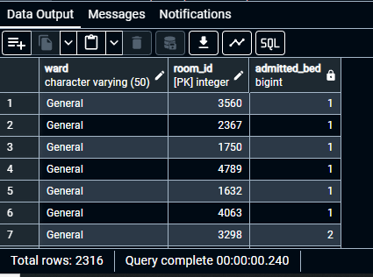

--33.Count total bed occupancy today (rooms with an admitted patient)
SELECT r.ward,r.room_id,
COUNT(ad.*) FILTER(WHERE ad.status='Admitted') AS admitted_bed
FROM room r
LEFT JOIN admission ad USING (room_id)
GROUP BY 1,2
HAVING COUNT(ad.*) FILTER(WHERE ad.status='Admitted')>=1
ORDER BY 1;
--35.How many beds available in ICU today by room
WITH bed AS(
WITH ads AS(
SELECT r.ward,r.room_id,
COUNT(ad.*) FILTER(WHERE ad.status='Admitted') AS admitted_bed
FROM room r
LEFT JOIN admission ad USING (room_id)
GROUP BY 1,2
HAVING COUNT(ad.*) FILTER(WHERE ad.status='Admitted')>=1
ORDER BY 1
)
SELECT r.ward,r.room_id,
ads.admitted_bed,
r.bed_count,
r.bed_count - ads.admitted_bed AS bed_available
FROM room r
LEFT JOIN ads USING (room_id)
WHERE r.ward='ICU'
)
SELECT SUM(bed_available)
FROM bed
WHERE bed_available>0;

Slide 28
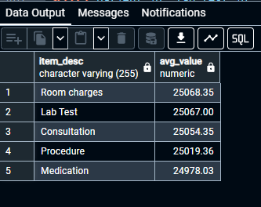
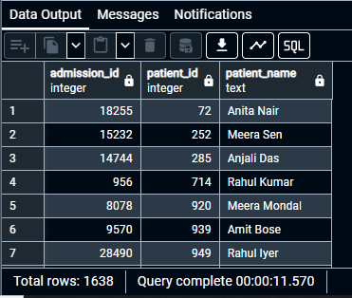
--36.Average invoice line value grouped by item_desc (top 10 expensive line types)
SELECT item_desc,
ROUND(AVG(unit_price),2) AS avg_value
FROM invoice_line
GROUP BY 1
ORDER BY 2 DESC;
--37.Patients who had both X-ray and Surgery within same admission (identify complex cases)
SELECT DISTINCT a.admission_id,
p.patient_id,
p.first_name||' '|| p.last_name AS patient_name
FROM admission a
JOIN patient p USING (patient_id)
JOIN treatment ts ON ts.admission_id=a.admission_id
AND ts.description ILIKE '%X-Ray%'
JOIN treatment tx ON tx.admission_id=a.admission_id
AND tx.description ILIKE '%Surgery%'
ORDER BY 2;

Slide 29
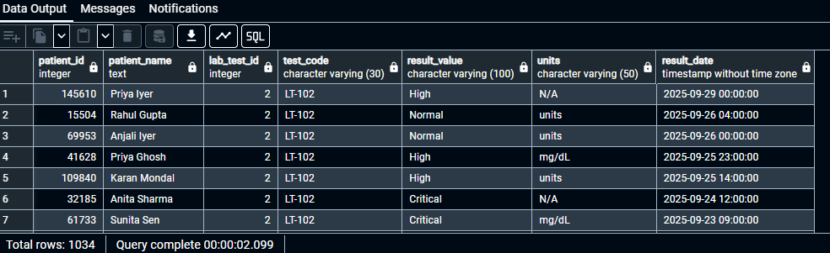
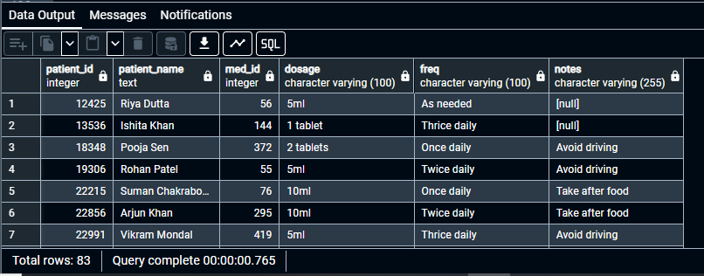
--38.Patients who received a specific lab test (e.g., 'LT-102') and their most recent result
WITH lr AS (
SELECT patient_id, lab_test_id, result_value, units,
MAX(result_date) AS result_date
FROM lab_result
GROUP BY 1,2,3,4
ORDER BY 1
)
SELECT p.patient_id,
p.first_name||' '|| p.last_name AS patient_name,
lr.lab_test_id, l.test_code, lr.result_value, lr.units,
lr.result_date
FROM patient p
JOIN lr USING (patient_id)
JOIN lab_test l USING (lab_test_id)
WHERE l.test_code = 'LT-102'
ORDER BY lr.result_date DESC;
--39.Patients with prescriptions active today
SELECT p.patient_id,
p.first_name||' '|| p.last_name AS patient_name,
pr.med_id,pr.dosage,pr.freq,pr.notes
FROM patient p
JOIN prescription pr USING (patient_id)
WHERE CURRENT_DATE BETWEEN pr.start_date AND pr.end_date
ORDER BY 1;

Slide 30
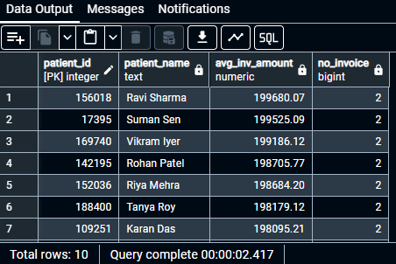
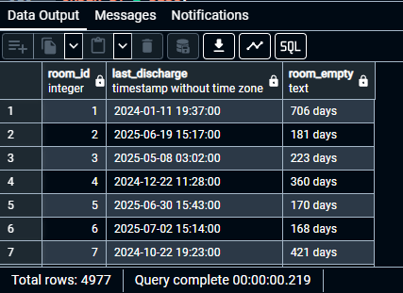
--40.Top 10 patients by average invoice amount (only patients with >=2 invoices)
SELECT p.patient_id,
p.first_name||' '|| p.last_name AS patient_name,
ROUND(AVG(i.total_amount),2) AS avg_inv_amount,
COUNT(i.*) AS no_invoice
FROM patient p
JOIN invoice i USING (patient_id)
GROUP BY 1
HAVING COUNT(i.*)>=2
ORDER BY 3 DESC
LIMIT 10;
--41.For each room, last admission end date (show room utilization recency)
SELECT room_id,
MAX(discharge_date) AS last_discharge,
CURRENT_DATE - MAX(discharge_date::DATE)||' '||'days' AS room_empty
FROM admission
WHERE status='Discharged'
GROUP BY 1
ORDER BY 1;

Slide 31
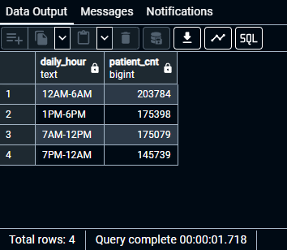
--42.Find appointment time slots most used (hour of day)
SELECT
CASE
WHEN EXTRACT(HOUR FROM appt_datetime) BETWEEN 0 AND 6 THEN '12AM-6AM'
WHEN EXTRACT(HOUR FROM appt_datetime) BETWEEN 7 AND 12 THEN '7AM-12PM'
WHEN EXTRACT(HOUR FROM appt_datetime) BETWEEN 13 AND 18 THEN '1PM-6PM'
ELSE '7PM-12AM' END AS daily_hour,
COUNT(*) AS patient_cnt
FROM appointment
GROUP BY 1
ORDER BY 2 DESC;

Slide 32
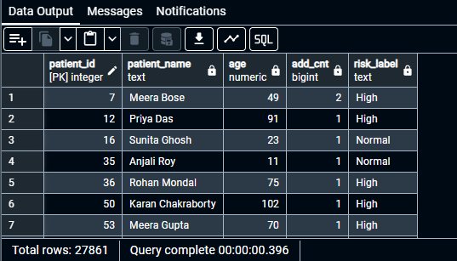
--43.Create a patient risk score (simple example) using CTEs and CASEs — high if >65 or multiple admissions
WITH pg AS(
SELECT patient_id,
first_name||' '||last_name AS patient_name,
EXTRACT(YEAR FROM AGE(CURRENT_DATE,dob)) AS age
FROM patient
),
ad AS(
SELECT patient_id,
COUNT(*) AS add_cnt
FROM admission
GROUP BY 1
)
SELECT pg.patient_id, pg.patient_name, pg.age,
ad.add_cnt,
CASE
WHEN pg.age>=65 AND ad.add_cnt>=2 THEN 'Very High'
WHEN pg.age>=65 OR ad.add_cnt>=2 THEN 'High'
WHEN pg.age BETWEEN 45 AND 64 OR ad.add_cnt>=2 THEN 'Medium'
ELSE 'Normal' END AS risK_label
FROM pg
JOIN ad USING (patient_id);

Slide 33
Key Insights & Learning Outcomes
Analytical Insights Delivered
Professional Skills Developed
Identified peak appointment hours (9-11 AM) for staffing optimization
Mastery of relational database design principles and normalization
Cardiology and Orthopedics emerged as highest-volume departments
Advanced SQL proficiency including CTEs, window functions, and complex joins
Top 10% of patients generated 45% of total revenue
Query optimization techniques for large-scale datasets
Average doctor efficiency: 12.3 appointments per day
Business intelligence and healthcare analytics expertise
Lab turnaround time averaged 2.4 days across all test types
Problem-solving with NULL handling and date-based analysis
Project Impact
This comprehensive hospital management system demonstrates enterprise-level database design capabilities and analytical SQL mastery. The project provides a strong foundation for data analyst, business intelligence, and database administration roles, showcasing the ability to transform complex operational requirements into actionable insights through structured data management.

